Slide 1
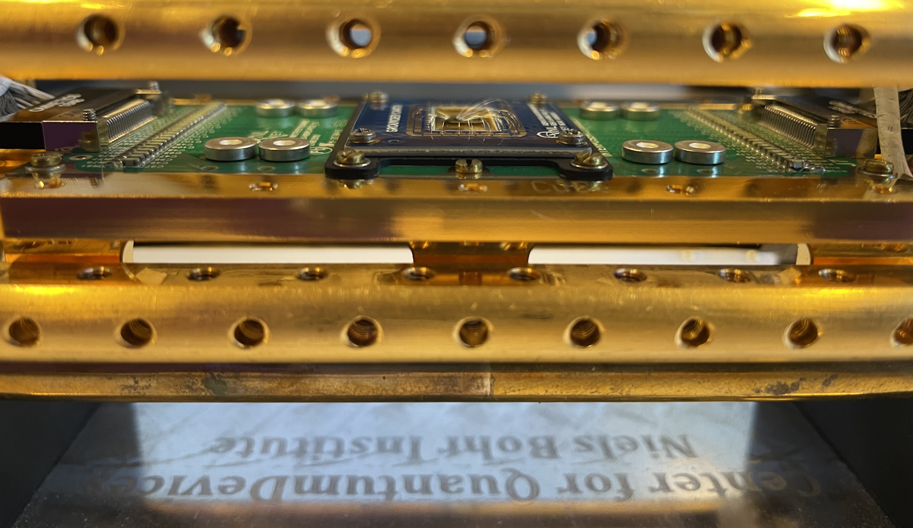


Welcome to the Center for Quantum Devices (Qdev)

Slide 2
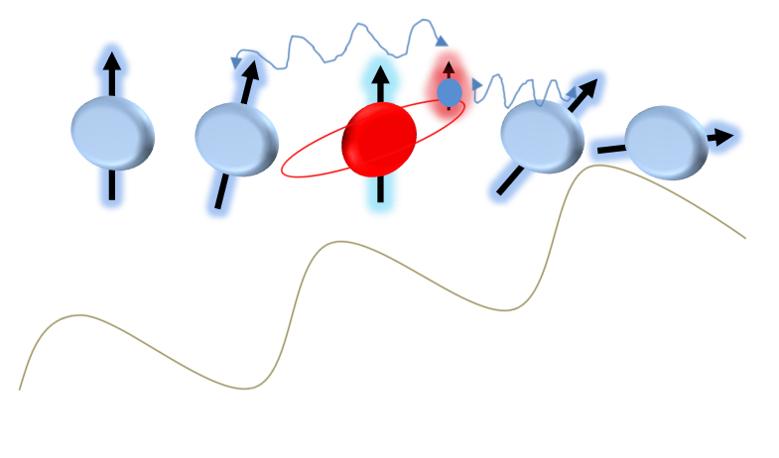
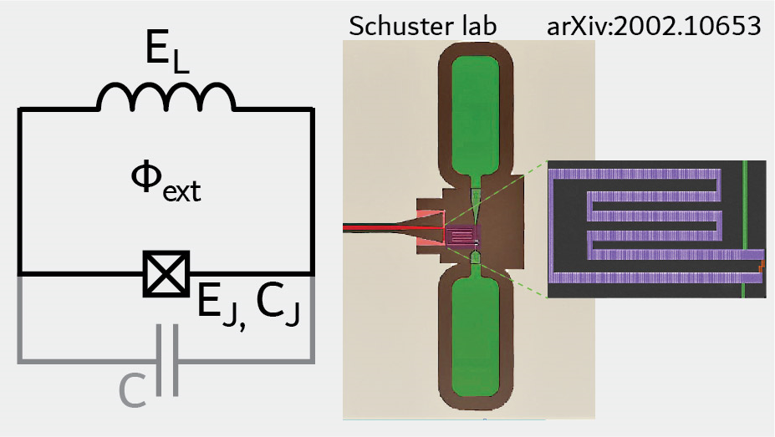
Who are we?
Harry
PhD candidate
Experimental work:
Fabrication & measurements of spin qubits
Amalie
Master student 1st year
Experimental work:
Fabrication & measurements of superconducting qubits
Notes:
Write down what year Harry are.

Slide 3
Outline
Quantum Physics
Quantum computing and quantum bits (Qubits)
The center for quantum devices
Fabrication and measurements
Lab tour

Slide 4
What are Qdev doing?
Qdev
Experiments
Theory
Qbits
Qubits
Superconducting qubits
Nanowires
Quantum Hall effect
Spin qubits
Many more
Many more
Qdev: Exploring Quantum phenomena in superconductors.
Subdepartment:
Fabricating qubits
Notes:
Explain what superconductors are:

Slide 5
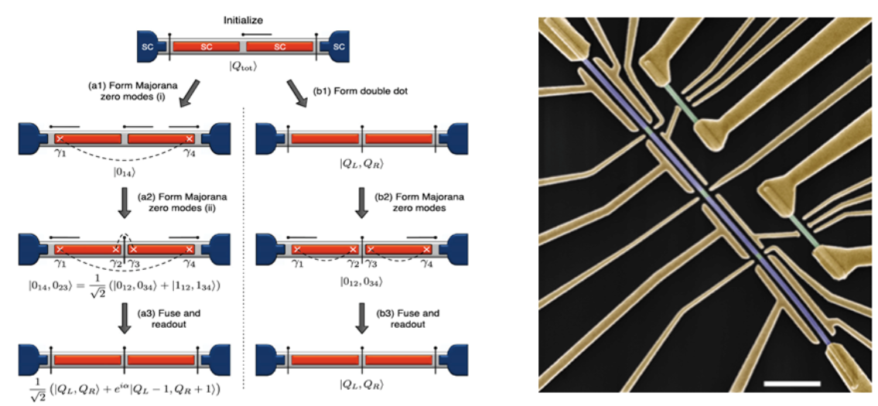
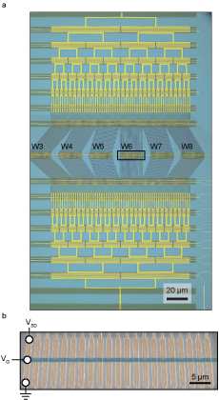
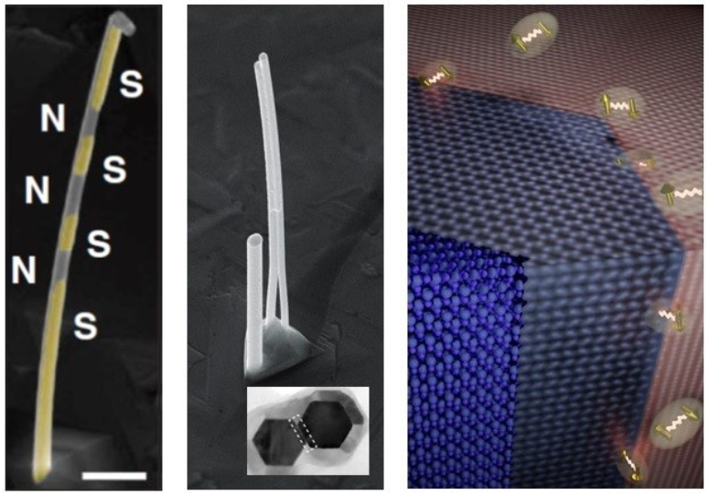
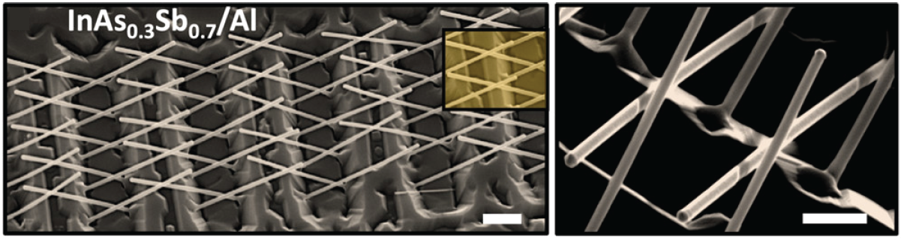
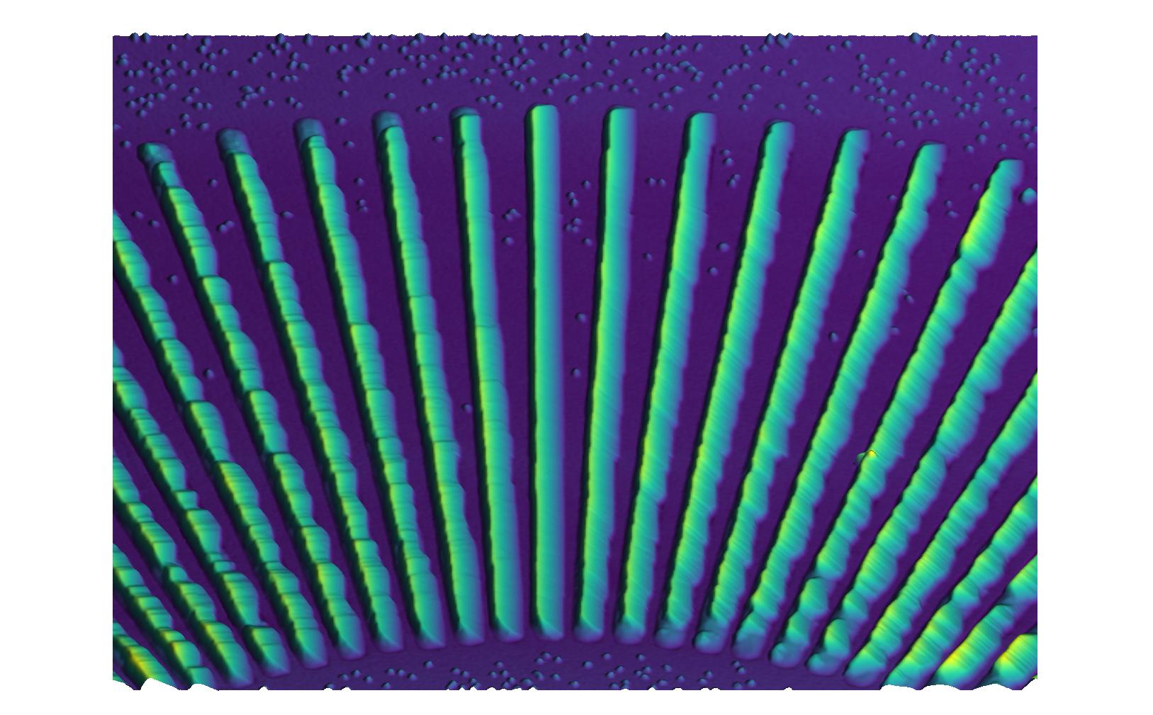
What we do
Theory
Novel devices
Quantum Materials

Slide 6

What does quantum mean?
Atoms:
Protons +
Neutrons n
Electrons e-
Quantized energy Atomic electron orbitals
Quantized light Photons
Notes:
Depending on the energy of the electron and how far it is from the orbital it has different energies. However, it can not have just an arbritary energy but only certain energies are allowed – we call this that the energies are quantized.

Slide 7
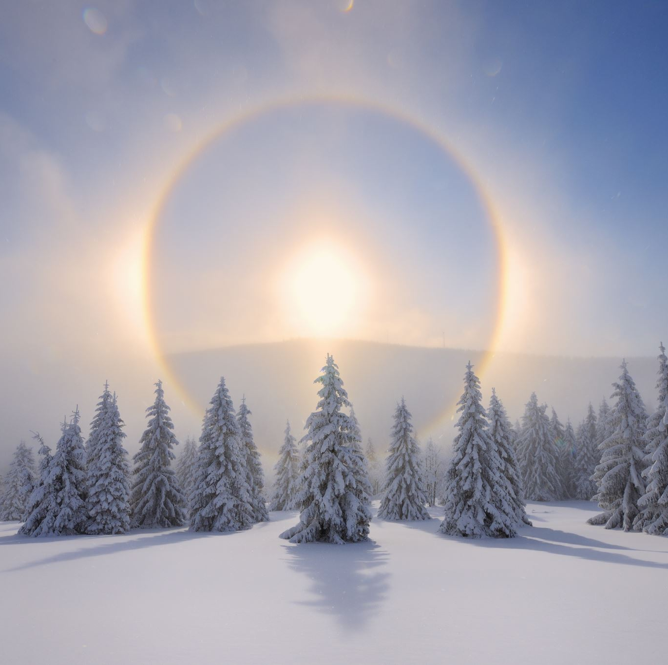
Quantum is extreme
Extremely cold temperatures
Extremely small length
Extremely high energies

Slide 8

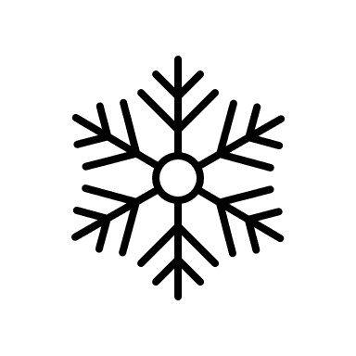


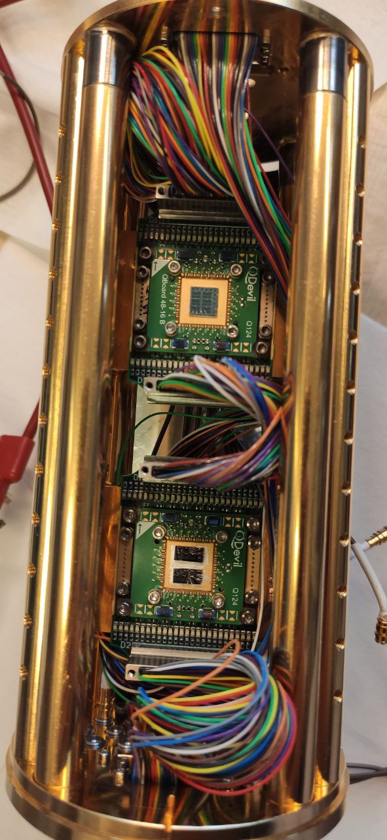
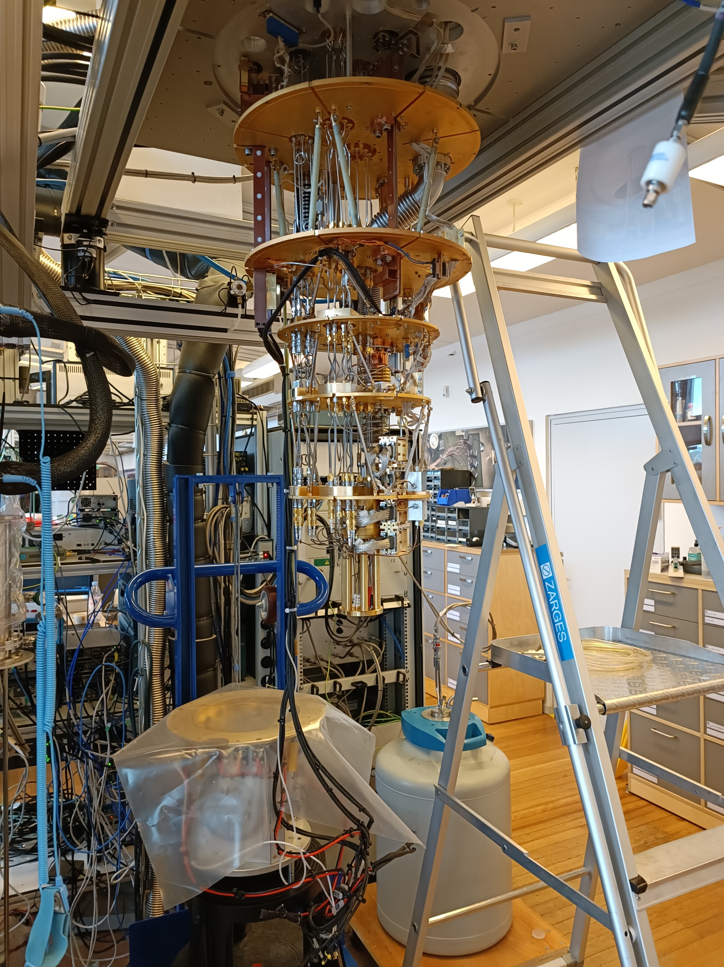
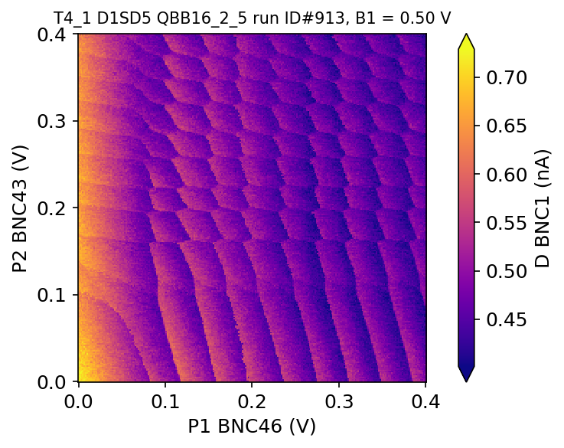
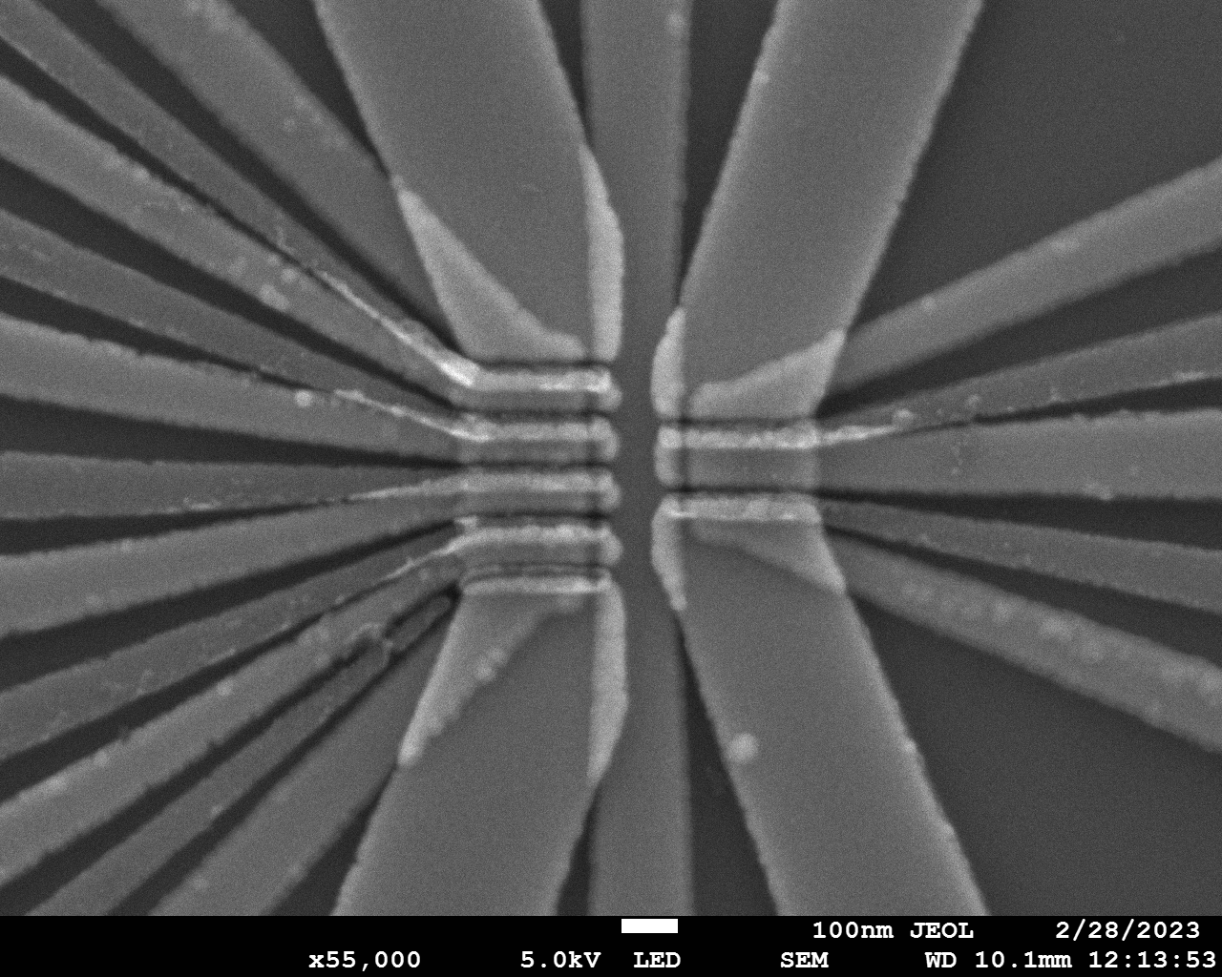

Our general target
Quantum computing
Quantum device (Qubit)
+ Refrigerator
= Measurement results

Slide 9
How do we make Qubits?

Slide 10
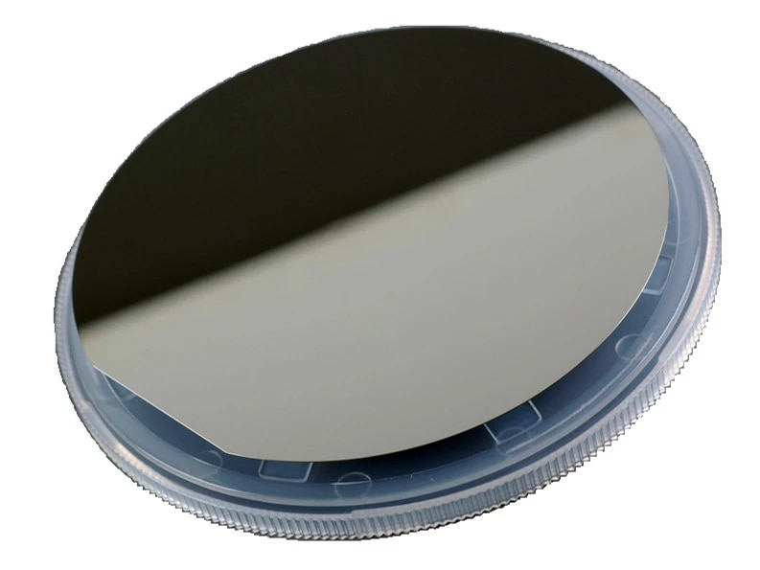

Slide 11
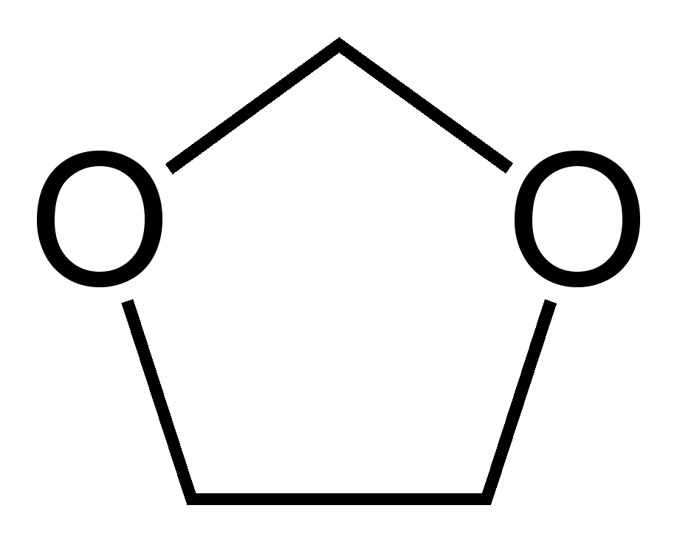
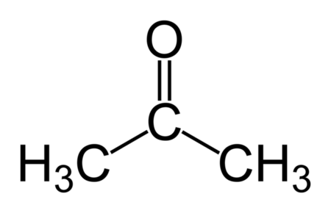
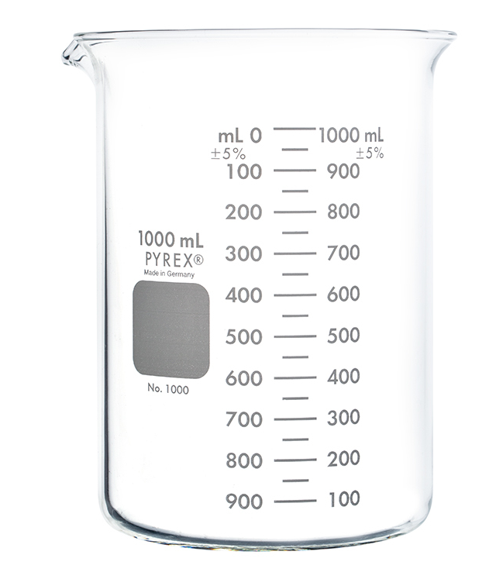

Slide 12
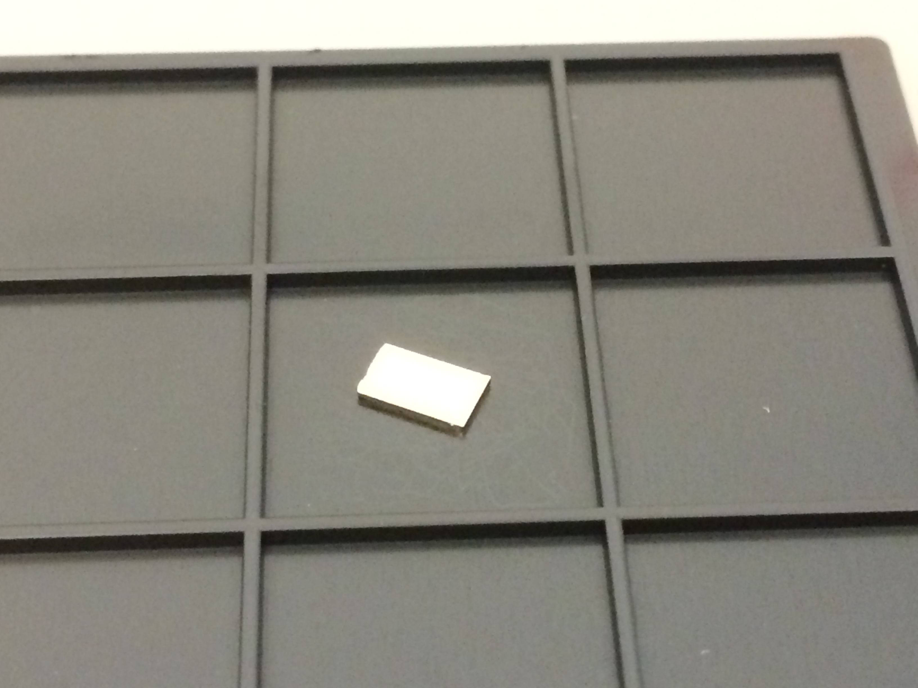
3 mm
5 mm

Slide 13
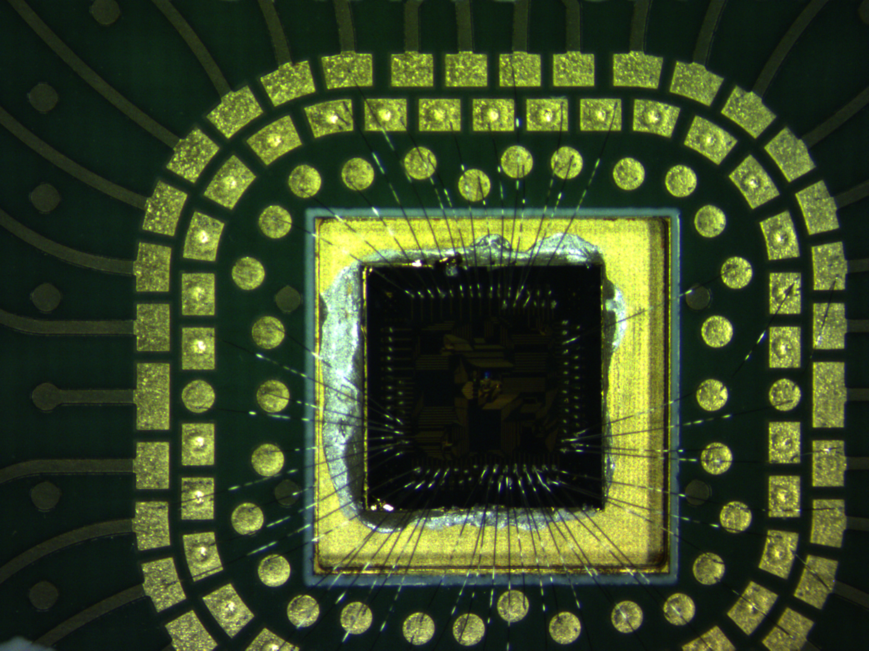
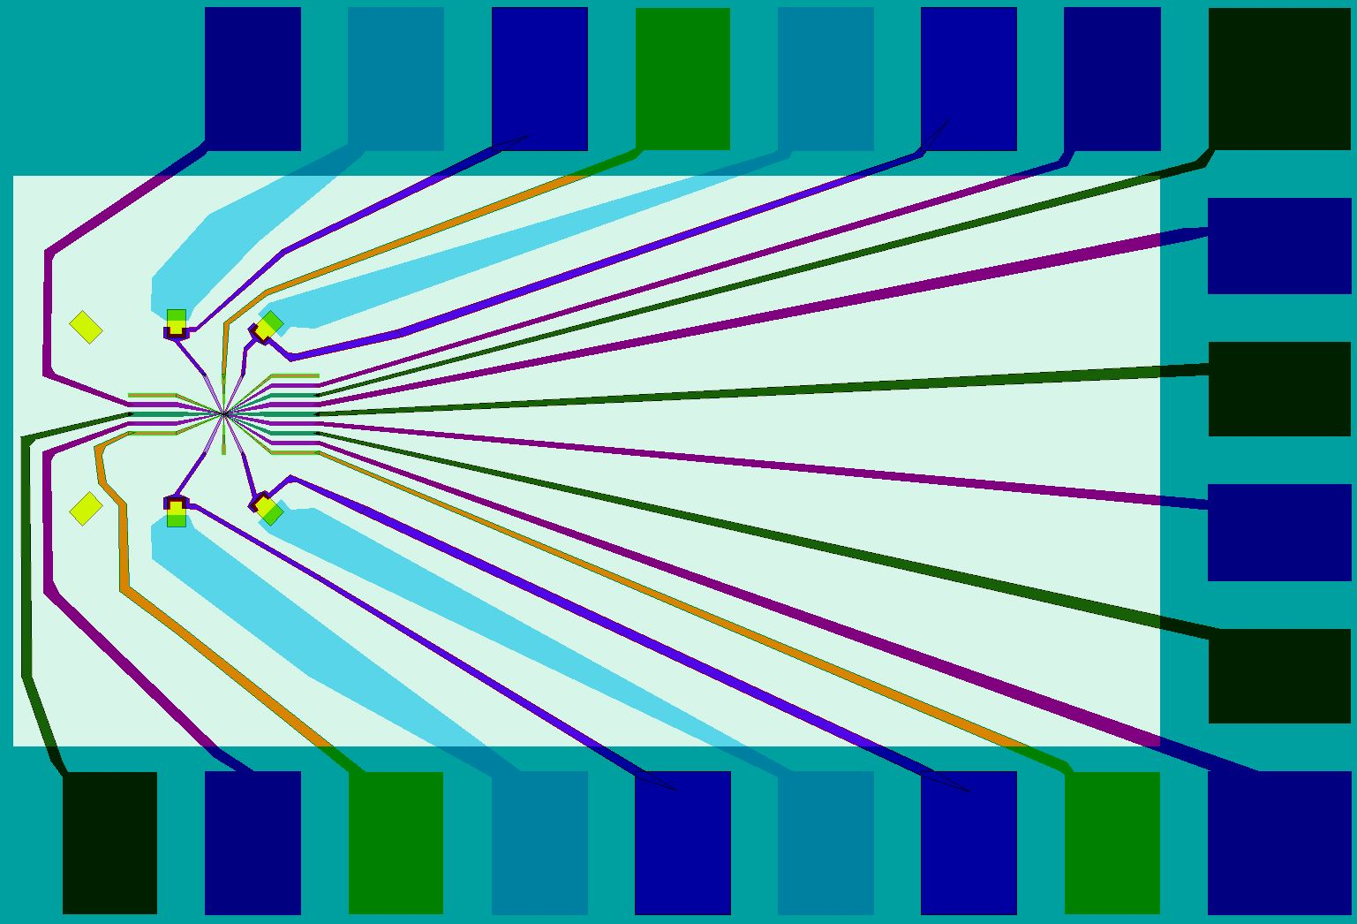
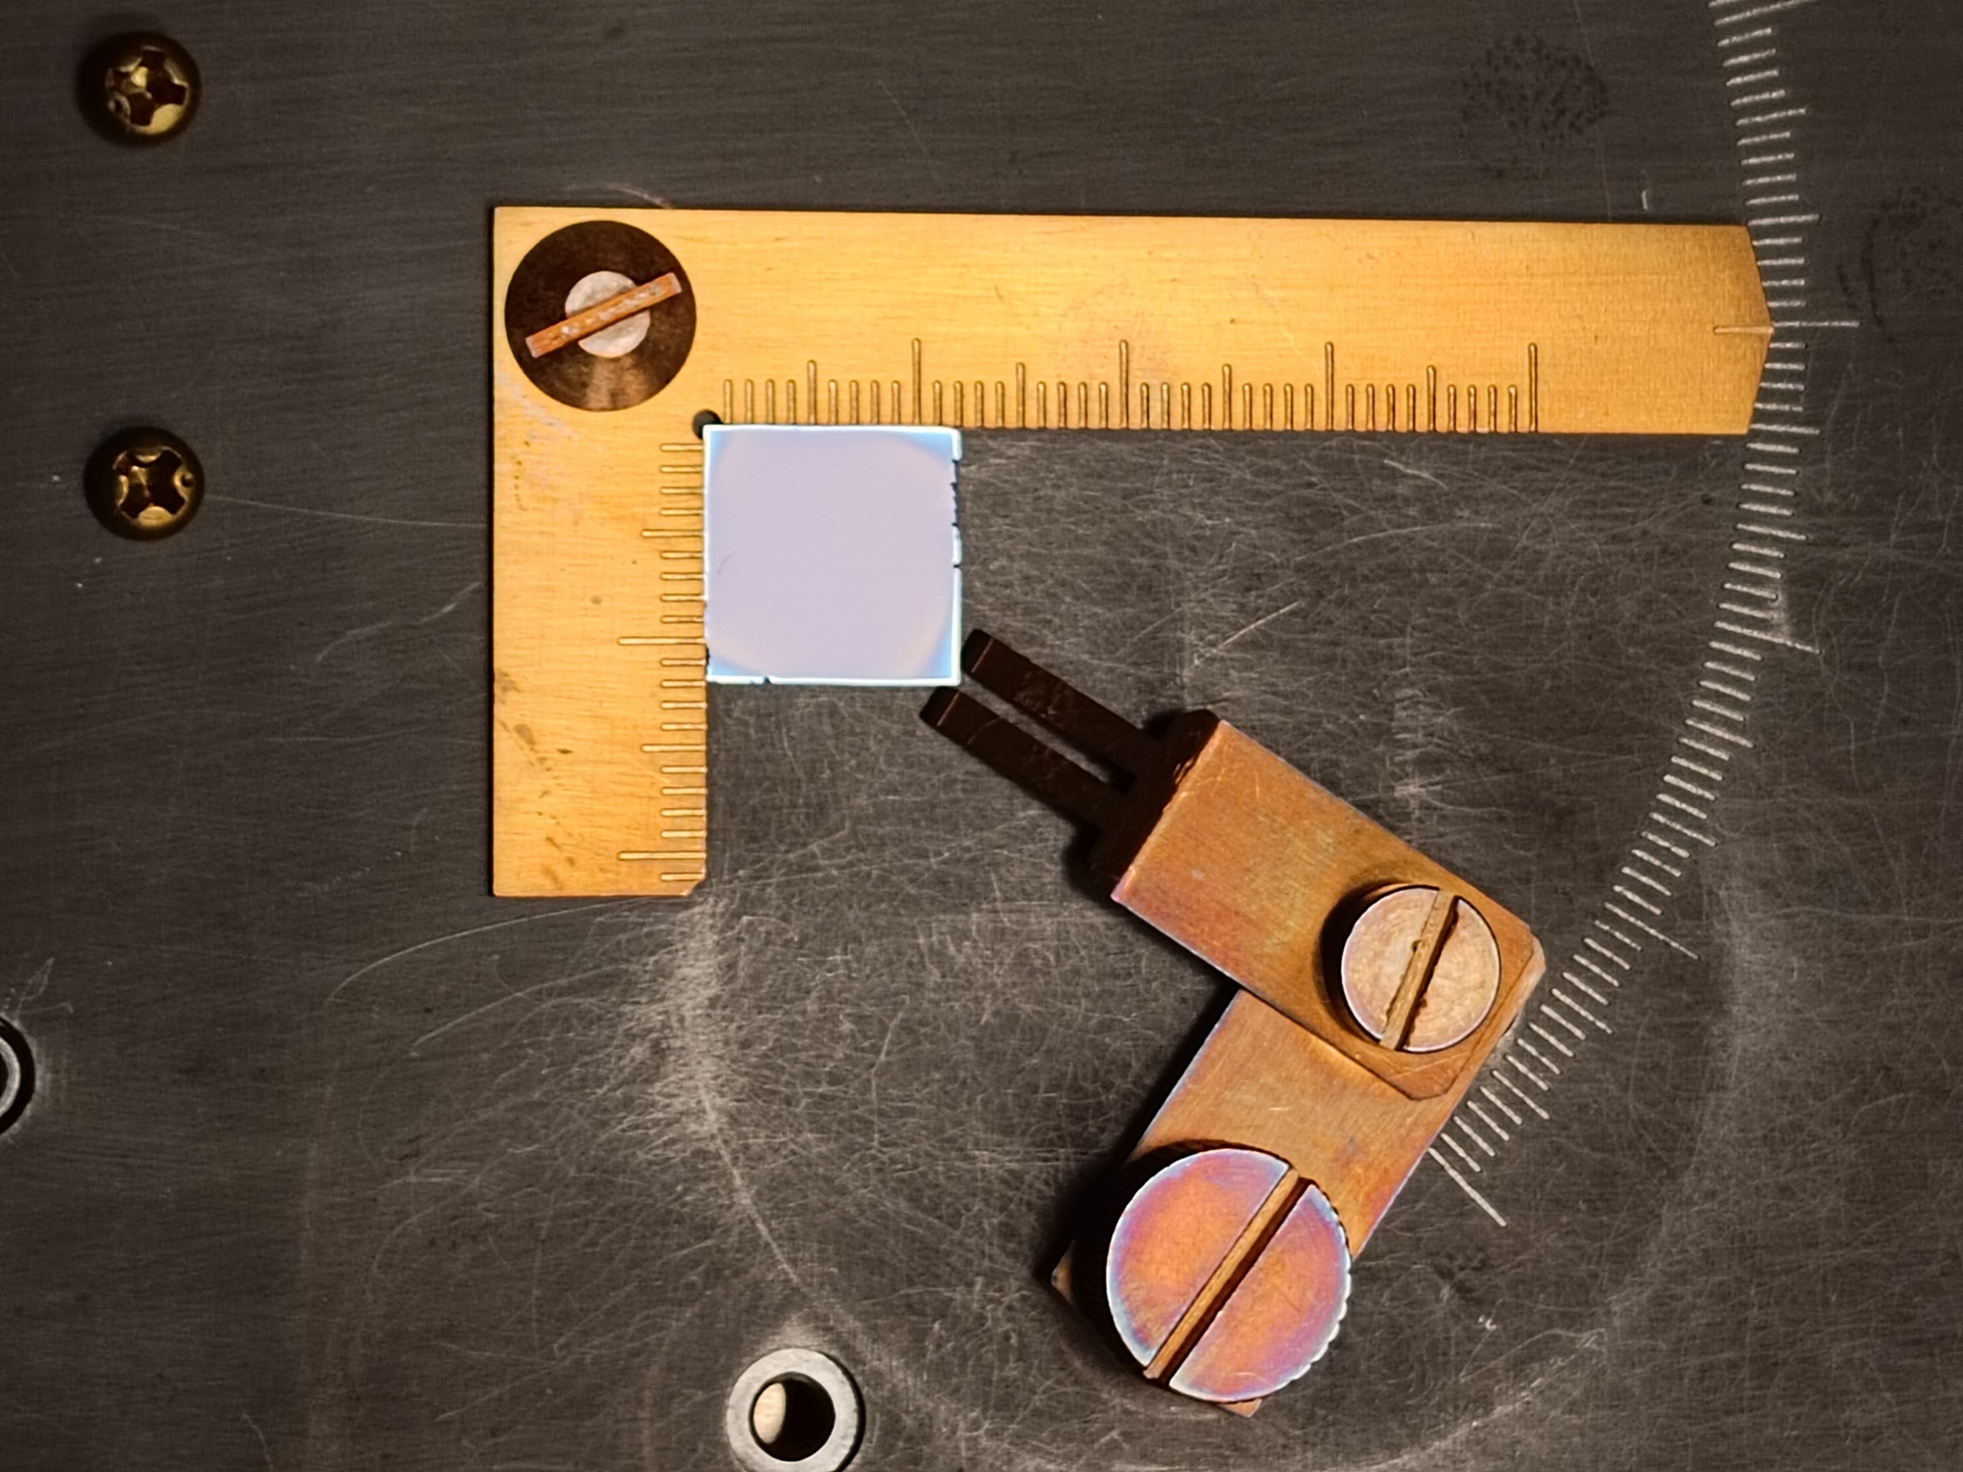
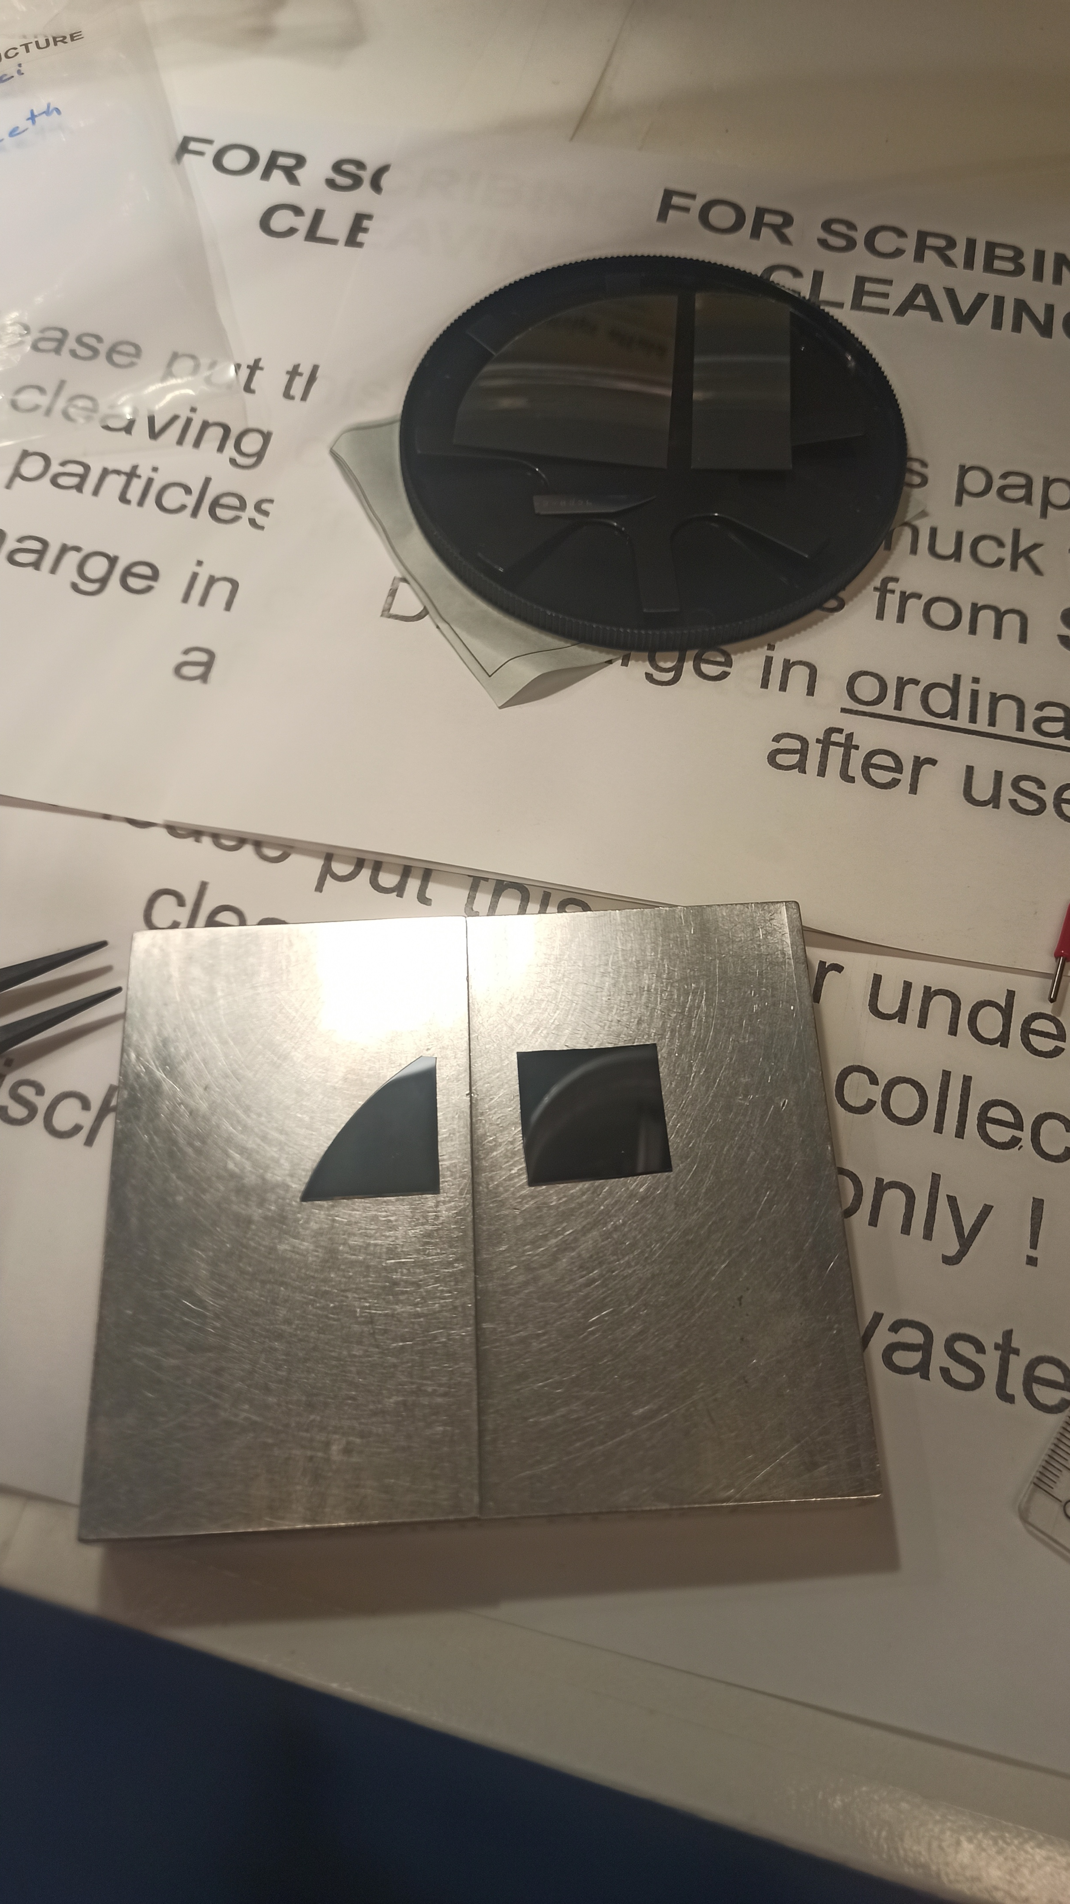
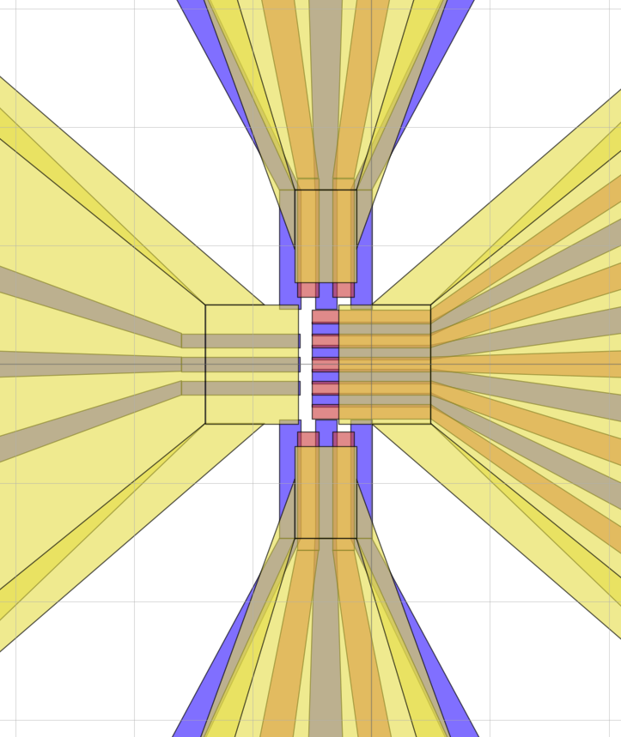
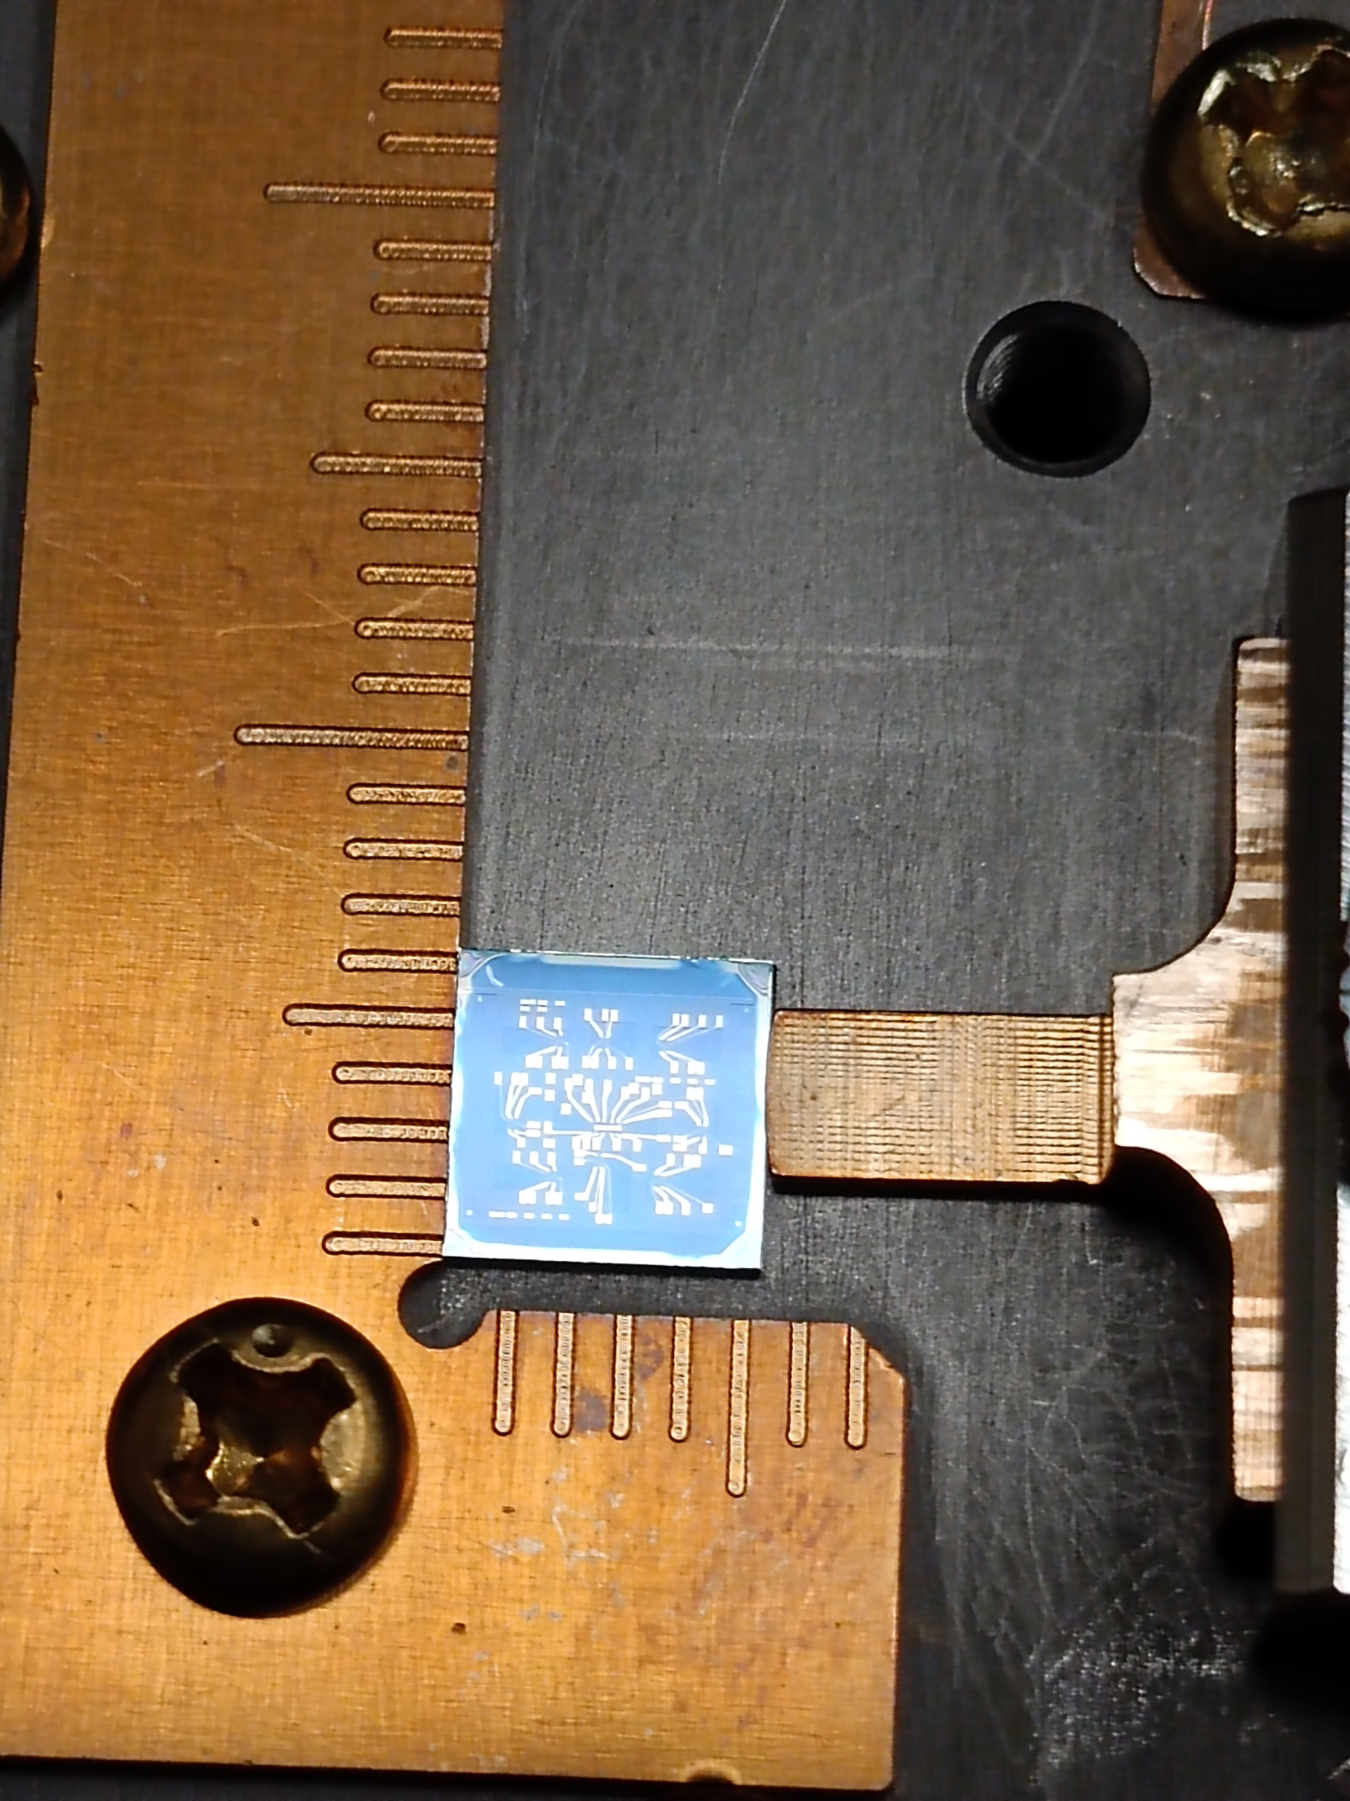
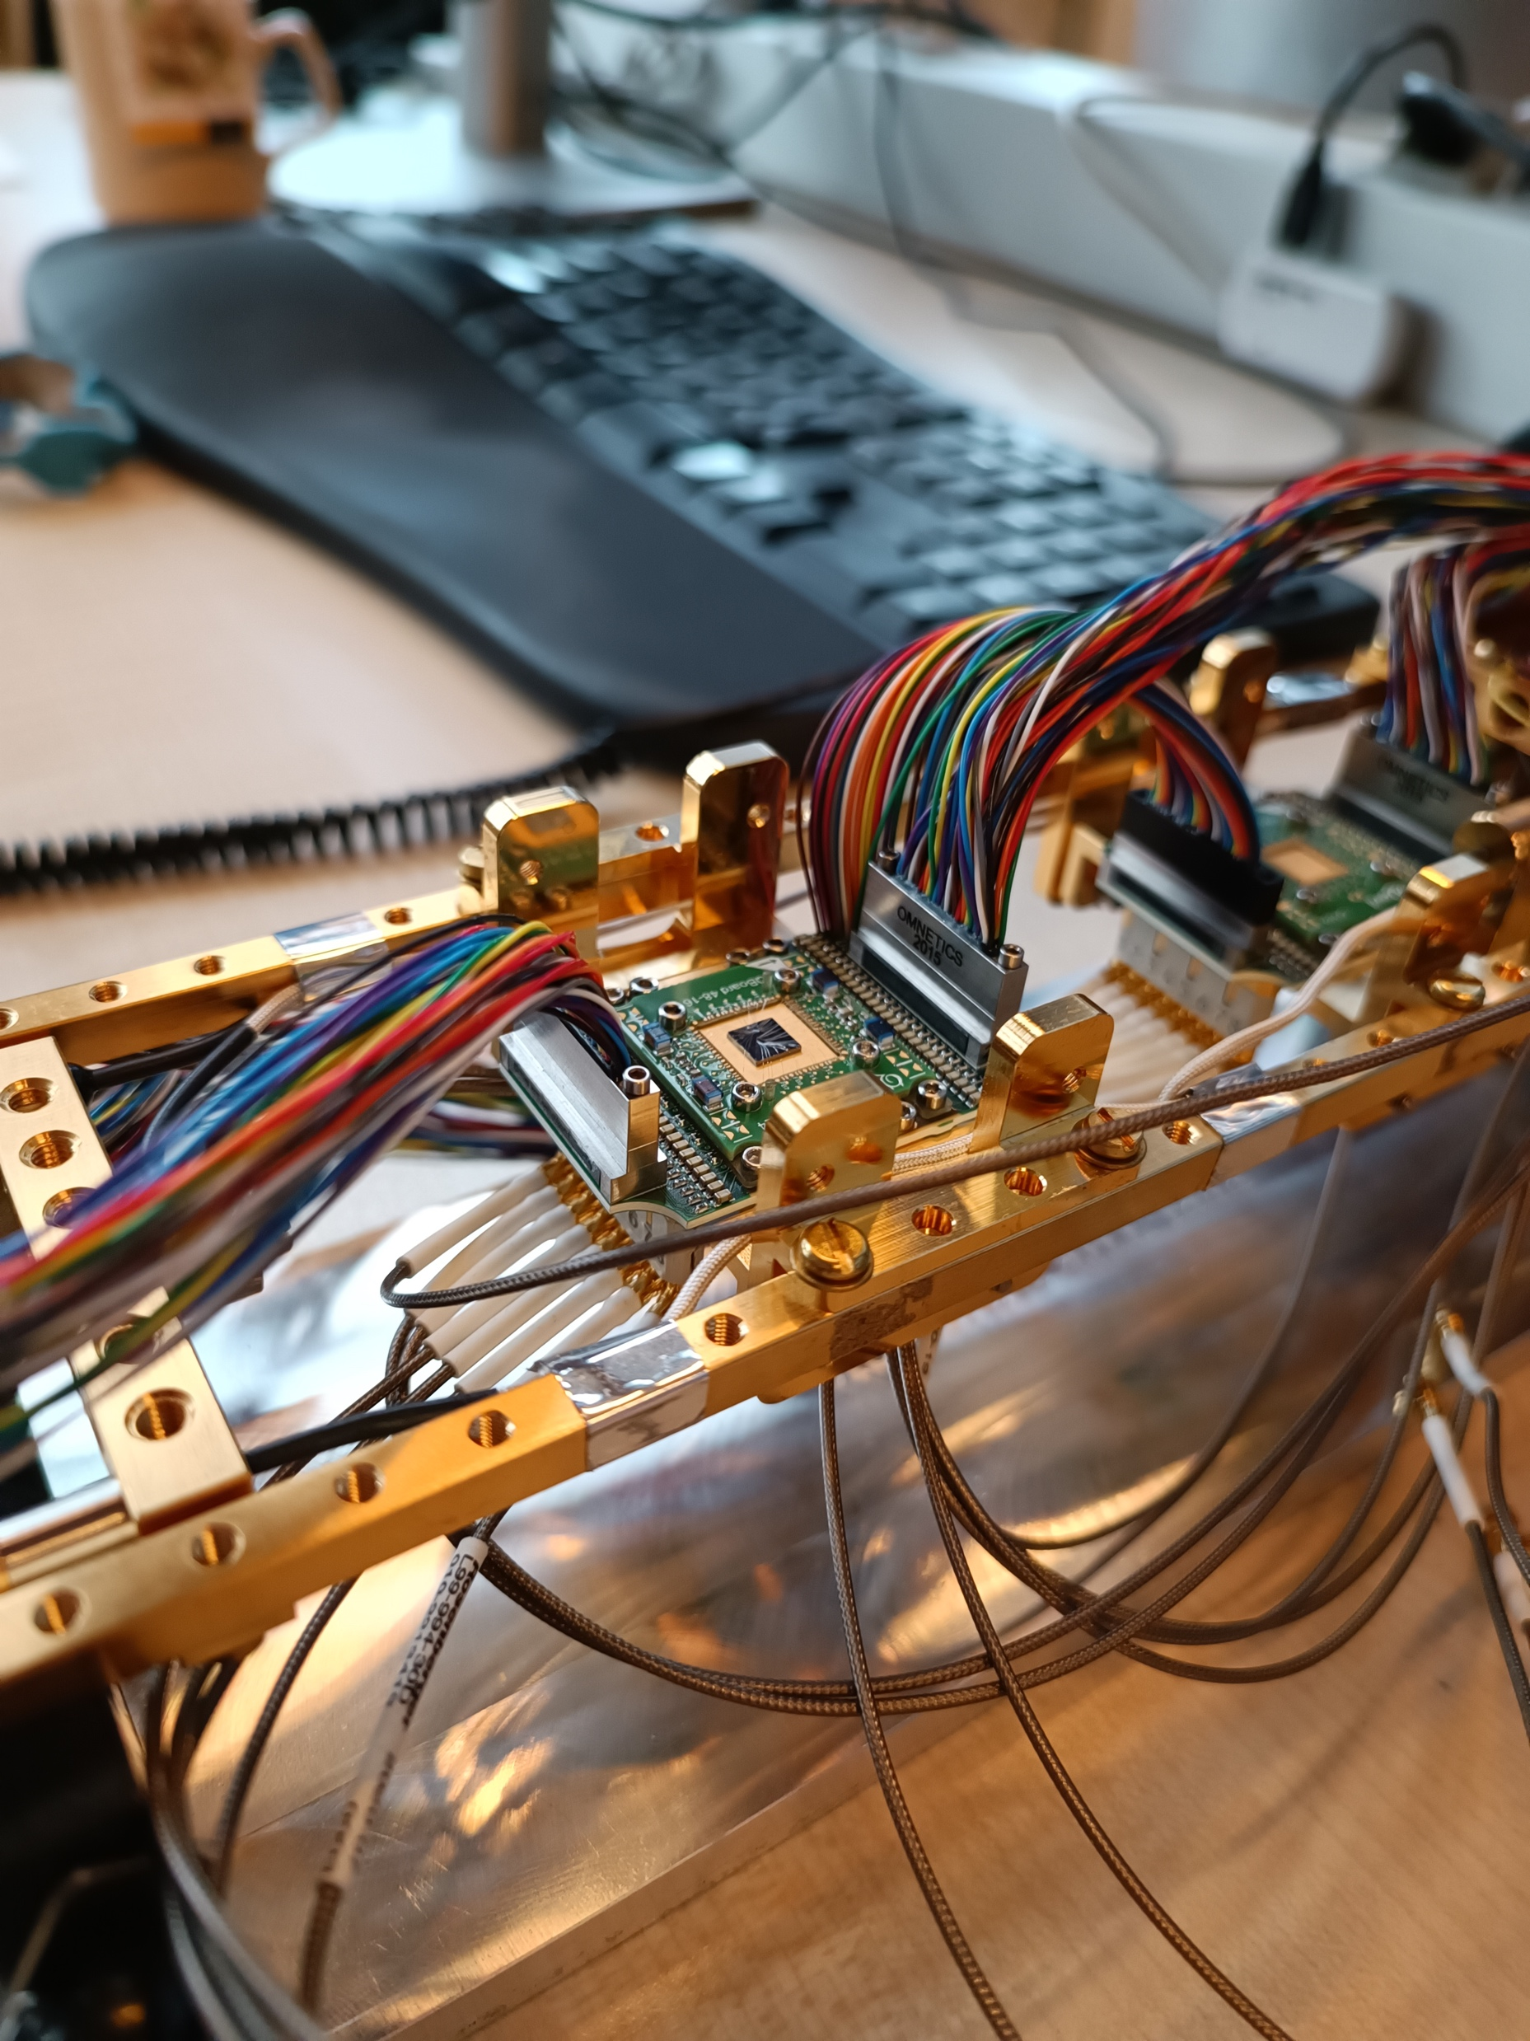
Quantum devices

Slide 14
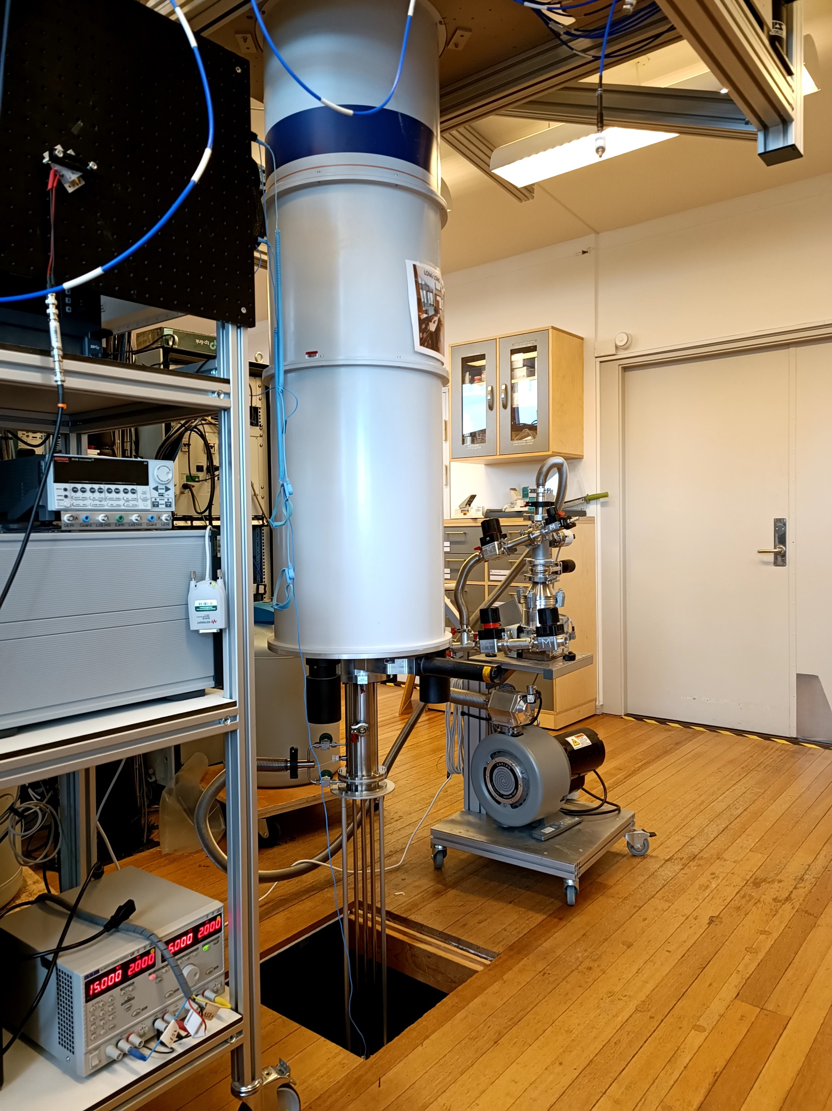
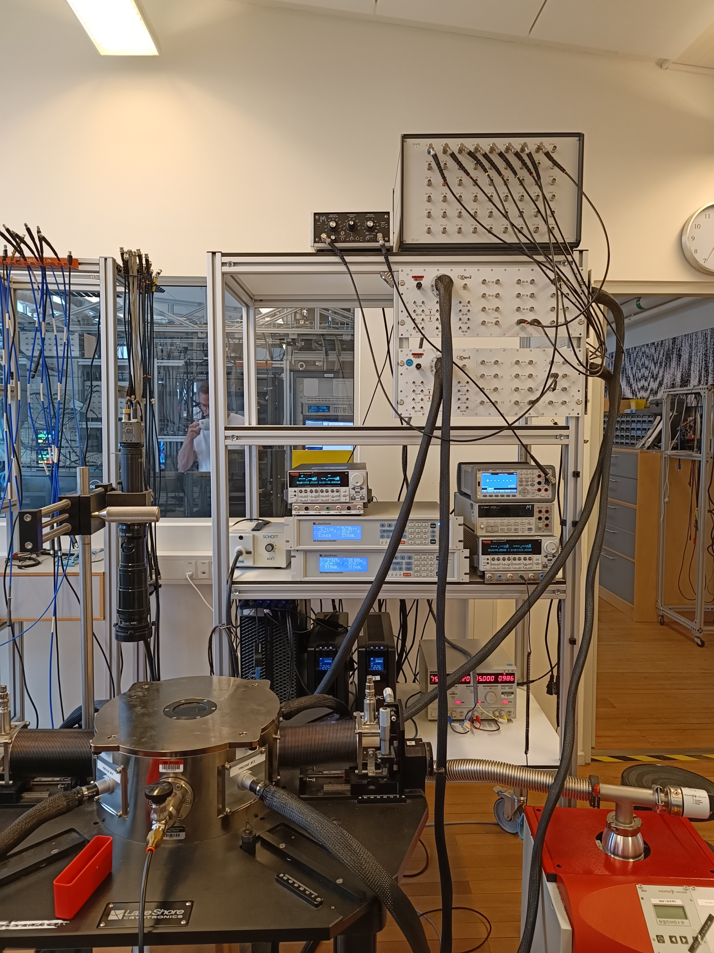
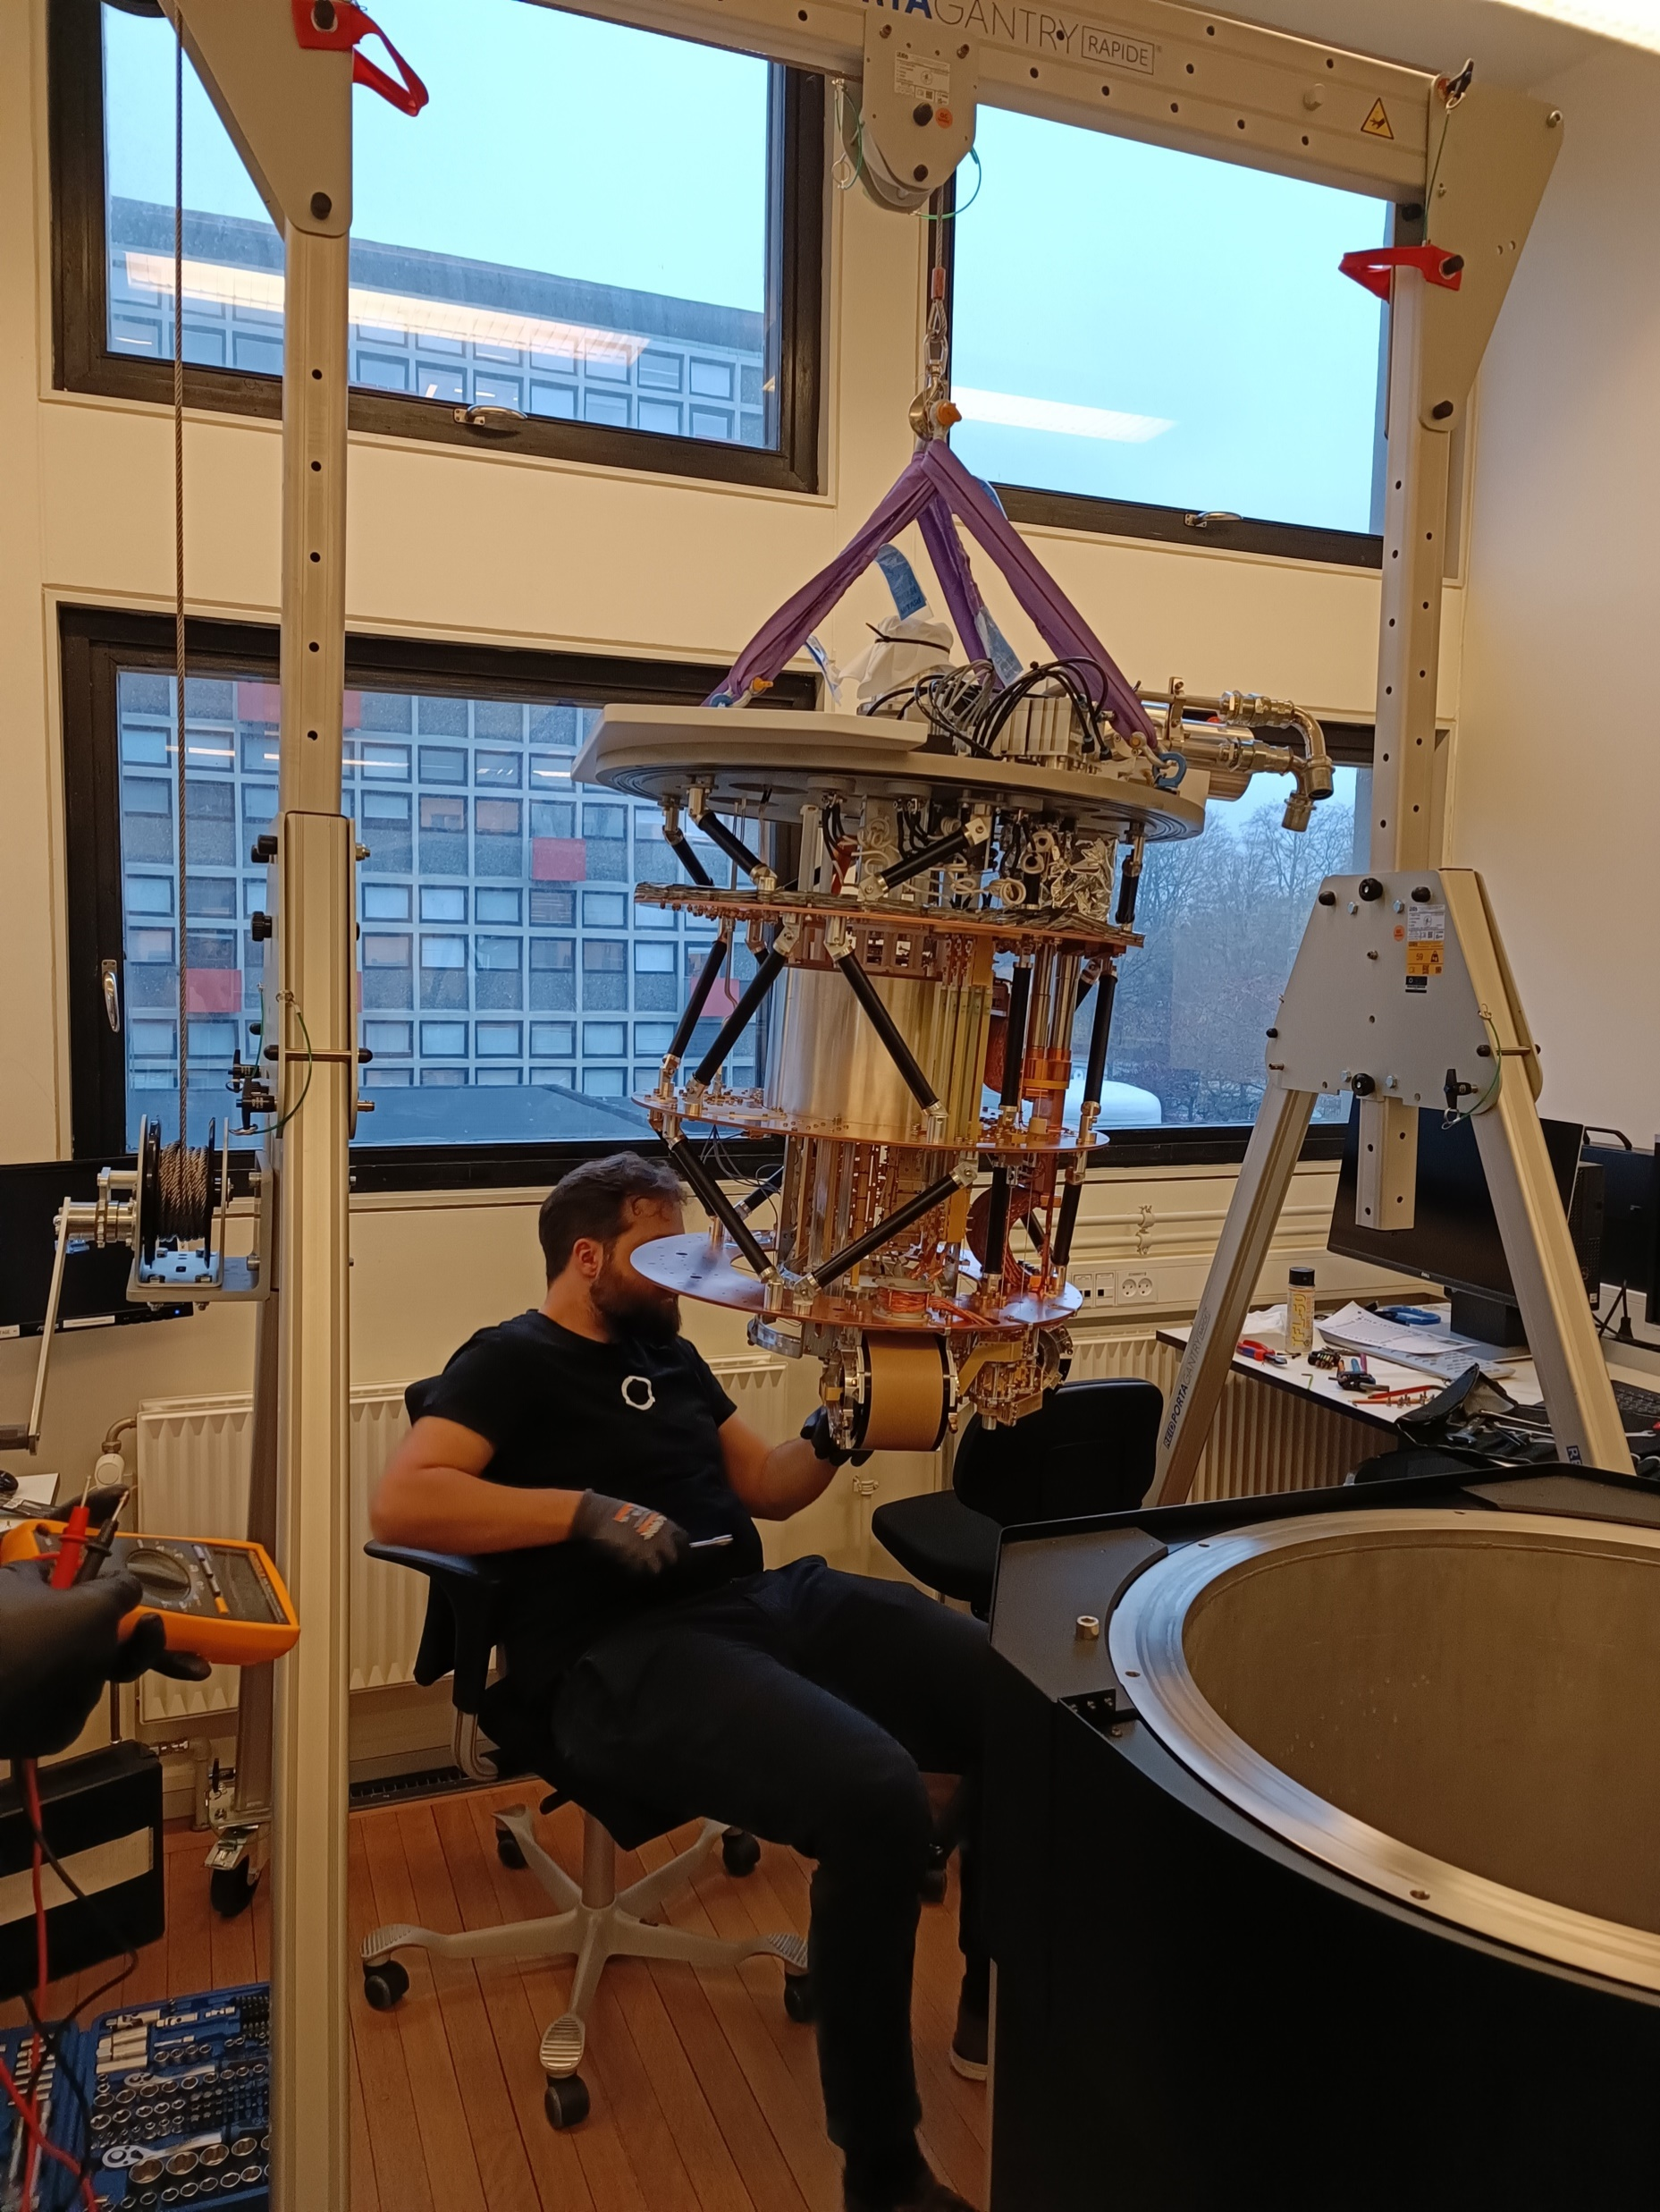
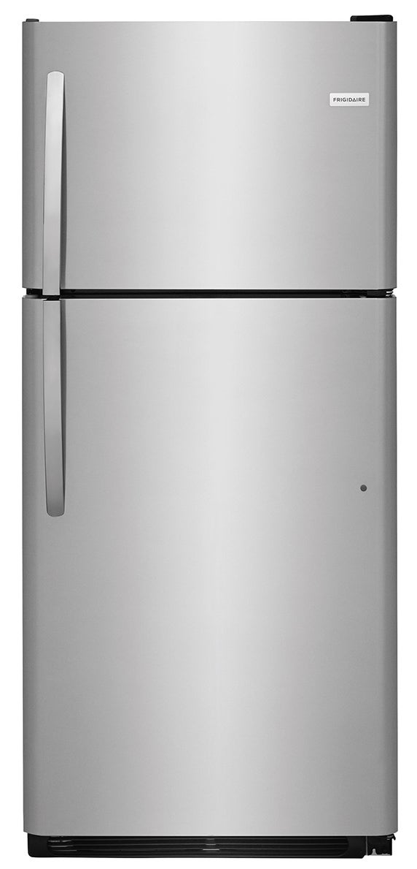
Refrigerators
-18°C
255K
4°C
277K
0.018K
-269 °C
4K
0.1K

Slide 15
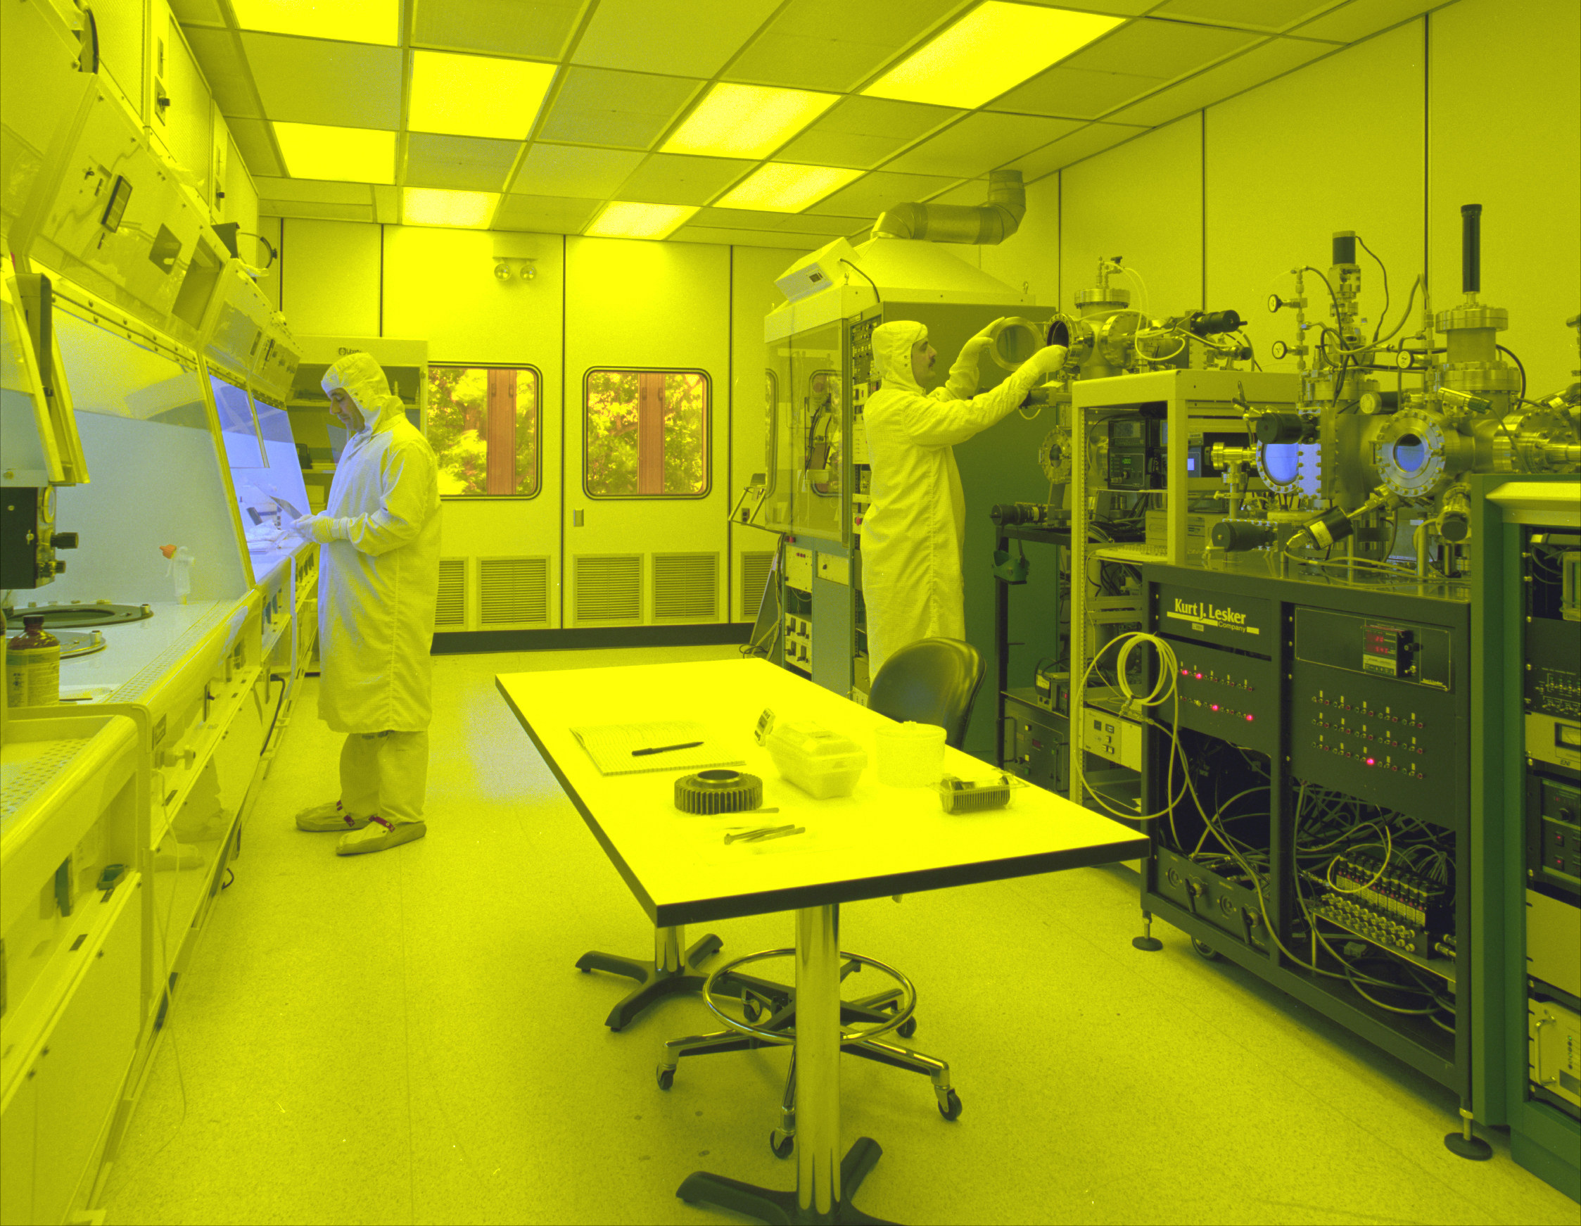
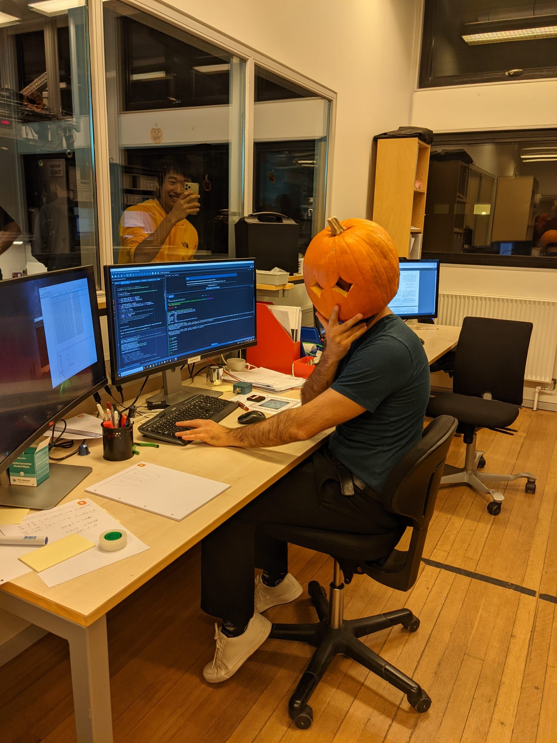
Our real life

Slide 16
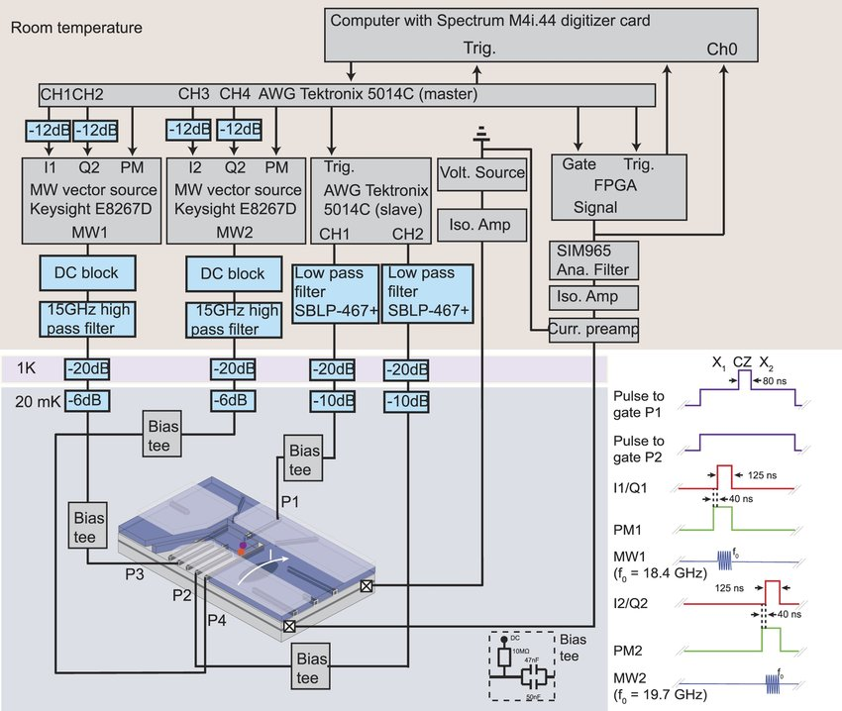
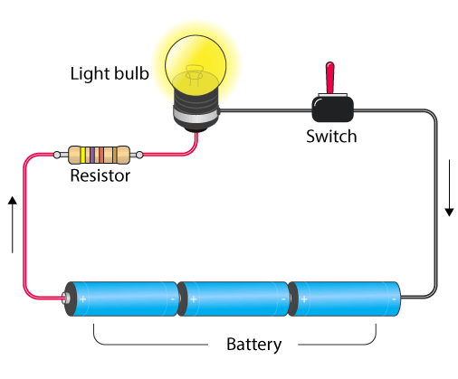
Measurements

Slide 17
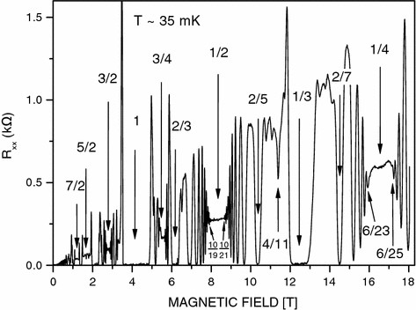
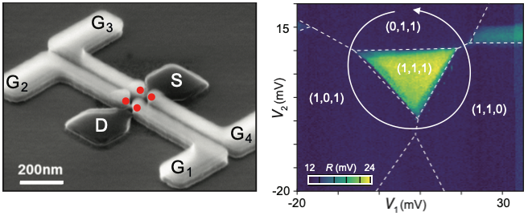
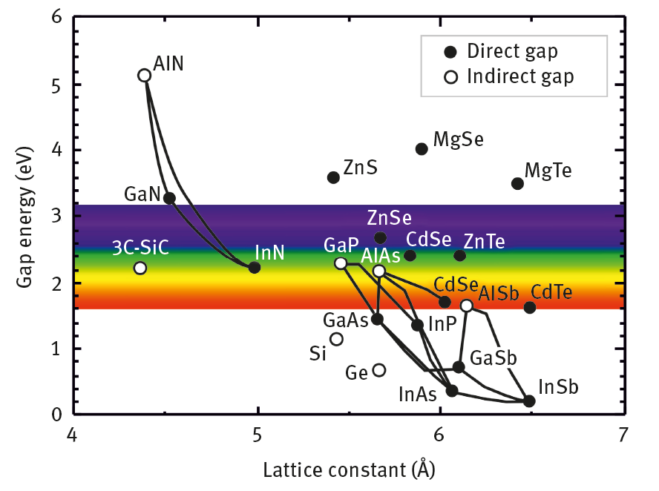
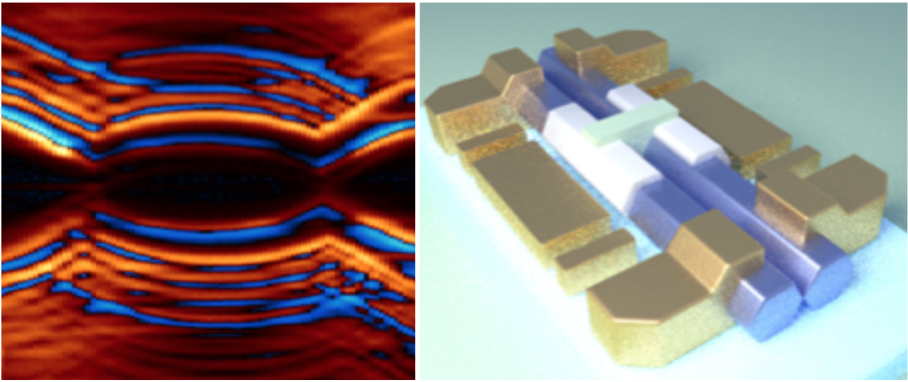
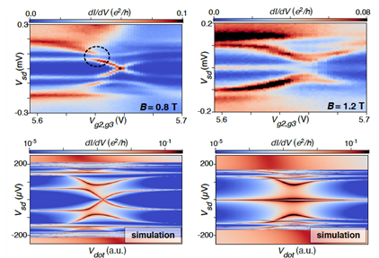
Results

Slide 18
Lab tour

